Slide 1
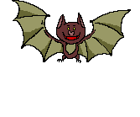
Gregor the overlander
Webquest

Slide 2
Bats
Bats are amazing!! Start your quest by rocking out with fruit bat to the tune, “Echolocation”. Listen to the song and fill in the missing rhyming words on your Questsheet.
Go to the next slide and click on the arrow to begin the video.

Slide 3

Bats!

Slide 4
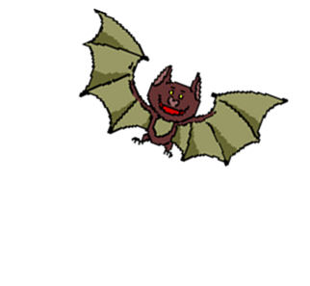
Go to the website listed below, follow the directions on your Quest Sheet, then watch the video and answer the questions on your Quest Sheet.
http://video.nationalgeographic.com/video/player/kids/

Slide 5

Lubee Foundation
http://www.batconservancy.org/kids-and-teacher-bat-resources
Right here in Gainesville we have a foundation that helps bats. It’s called the Lubee Bat Conservancy. Go to the website listed above and follow the directions on your Quest Sheet.

Slide 6
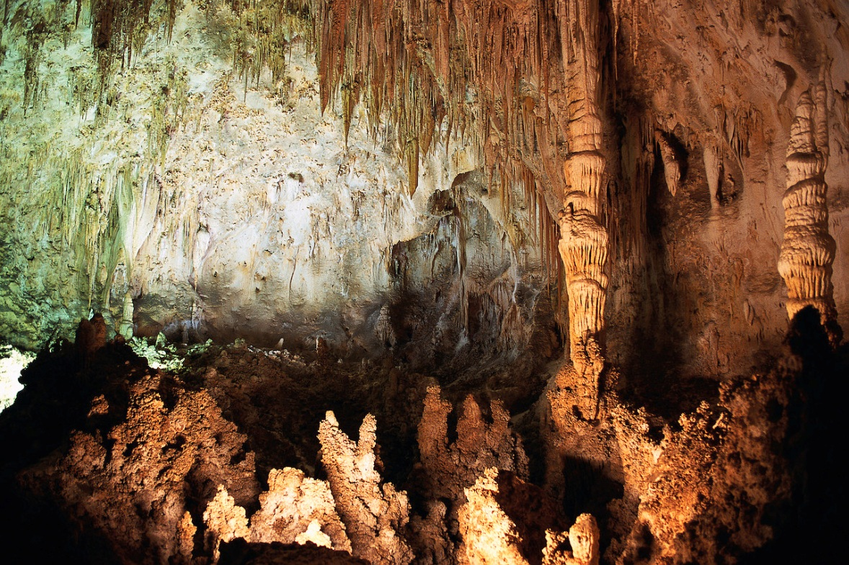
Next week…..
Enter the underland! CAVES!!!

